Slide 1


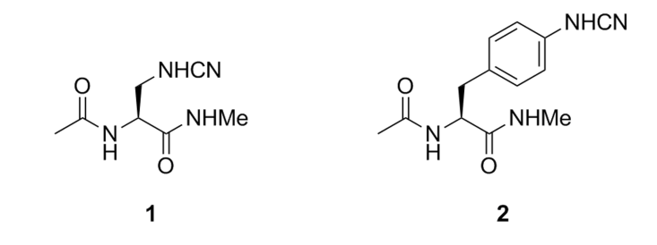
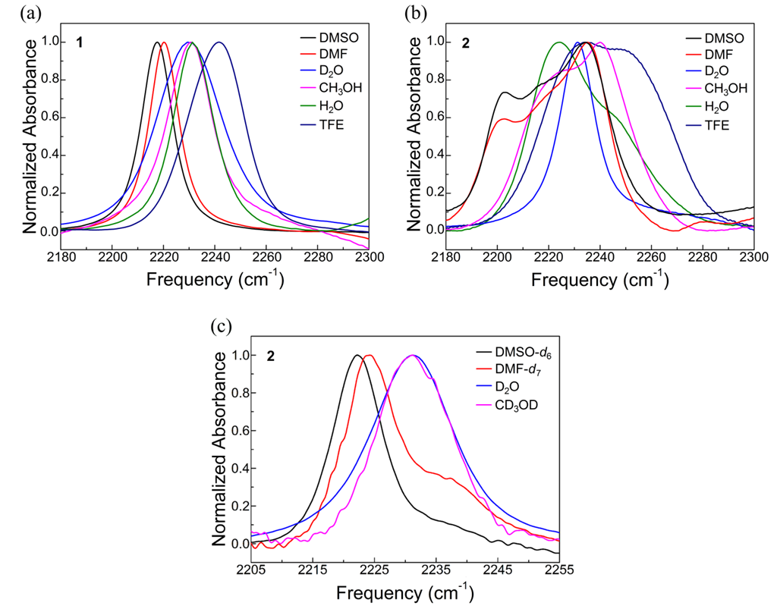
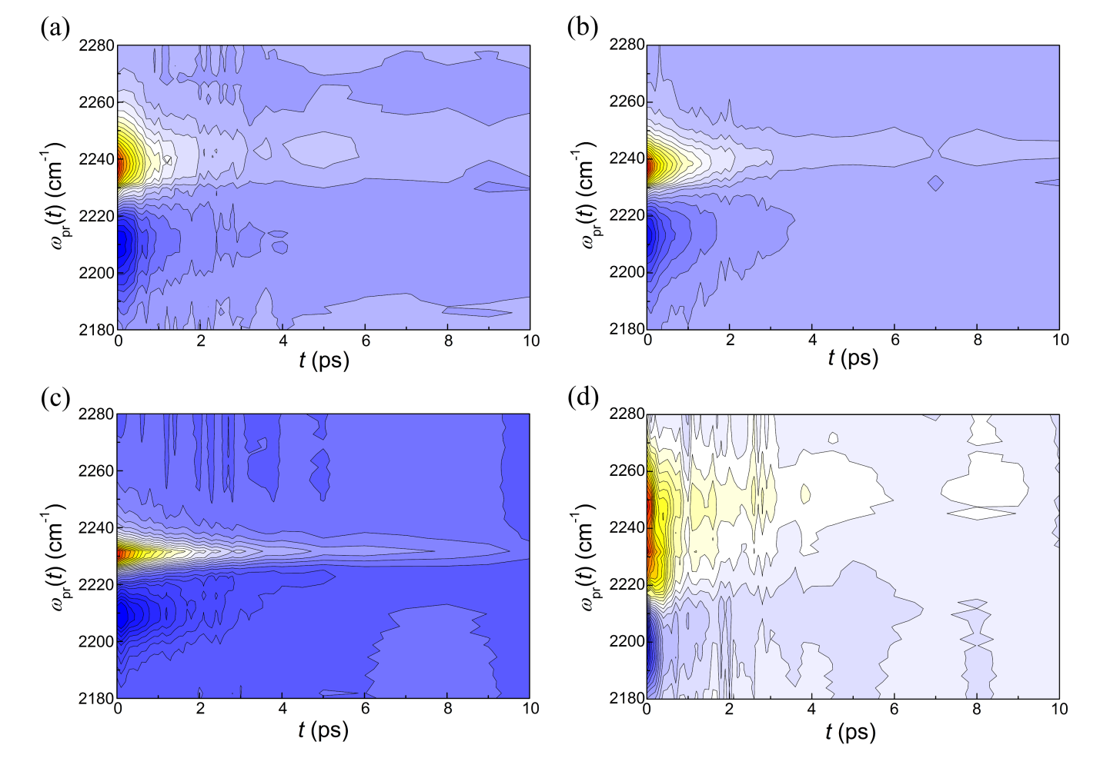
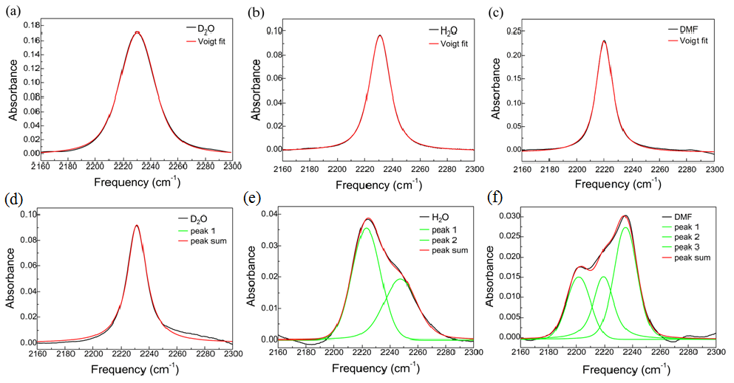
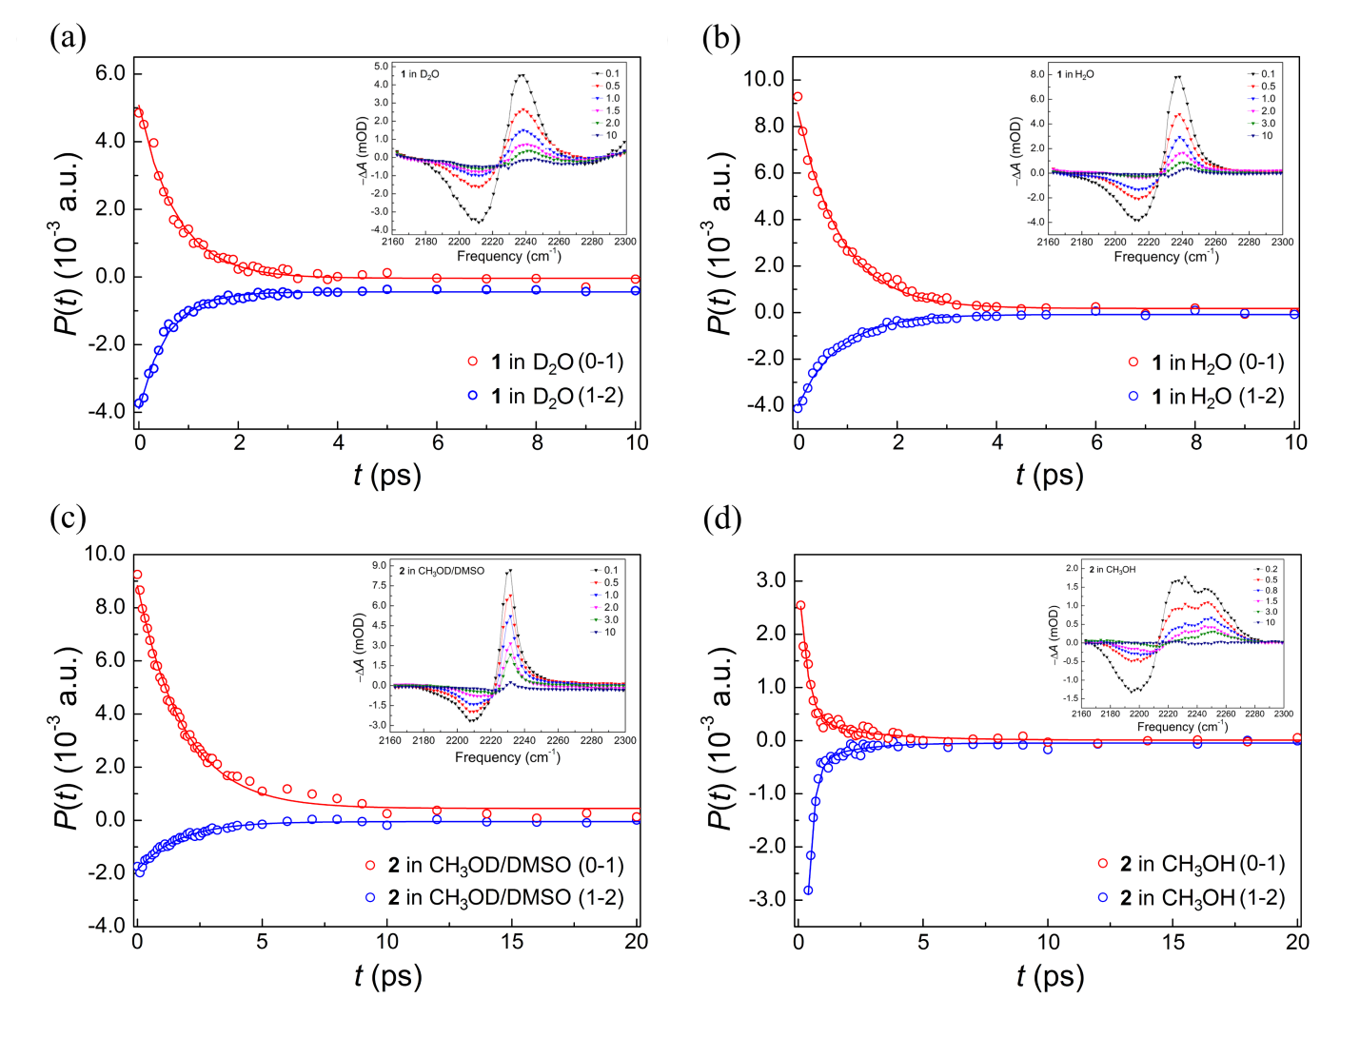
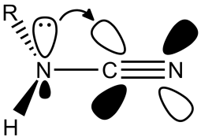
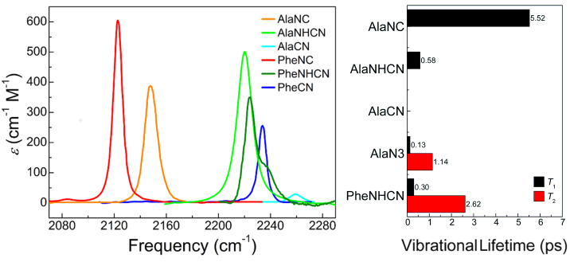
Cyanamide as an Infrared Reporter: Comparison of Vibrational Properties between Nitriles Bonded to N and C Atoms
Giseong Lee,#,‡ Dorota Kossowska,#, †,‡ Joonhyung Lim, †,‡ Soobin Kim, † Hogyu Han,*,‡ Kyungwon Kwak,*, †,‡
and Minhaeng Cho*,†,‡,§
†Center for Molecular Spectroscopy and Dynamics, Institute for Basic Science (IBS), Seoul 02841, Korea
‡Department of Chemistry, Korea University, Seoul 02841, Korea
§Multidimensional Spectroscopy Laboratory, Korea Basic Science Institute, Seoul 02855, Korea
Abstract
β-cyanamidoalanine (AlaNHCN) 1 and p-cyanamidophenylalanine (PheNHCN) 2 were synthesized. The vibrational properties of their CN stretch mode were studied using FTIR and femtosecond IR pump−probe spectroscopies. Aromatic cyanamide 2 shows a complicated lineshape of the FTIR spectrum, which arises from the accidental Fermi resonance, and can be substantially simplified by deuteration of the cyanamide (NHCN) into NDCN group. The transition dipole strengths of the cyanamide group are larger than those of the nitrile (CN) group, but comparable to those of the azido (N₃) and isonitrile (NC) groups. The vibrational lifetimes of the cyanamide group are similar to those of the nitrile and azido groups, but shorter than those of the isonitrile group. It is believed that cyanamide has the potential to be a good IR reporter of the conformational and environmental structure and dynamics of biomolecules in complementary to nitrile.
1. Structure
2. Scheme
3. Scheme
Figure 1. Structures of IR probes 1 and 2.
Scheme 1. (a) Ac₂O, Et₃N, DMAP, CH₂Cl₂ , rt, 80%; (b) 40% MeNH₂,
MeOH, rt, 85%; (c) TFA, rt, 85%¹; (d) BrCN, Me₃N, THF, 0 °C, 72%.
Scheme 2. (a) 40% MeNH₂, MeOH, rt, 100%²; (b) BrCN, THF/Et₂O (1:1), 65 °C, 56%.
4. FTIR spectra
6.
5. FTIR spectra
6. IR Pump−probe Data
Figure 2. Voigt fitting to FTIR spectra of 1 in (a) D₂O, (b) H₂O, and (c) DMF, Voigt fitting to FTIR spectra of 2 in (a) D₂O, (b) H₂O, and (c) DMF.
Figure 3. Solvent-dependent FTIR spectra of 1 and 2. In (c), the samples were deuterated with D₂O and then dried before they were dissolved in deuterated solvents.
Figure 4. Time- and frequency-resolved isotropic IR pump−probe signals at the delay time t for 1 in D₂O (a) and H₂O (b), and 2 in CH₃OD/DMSO (1:1 v/v) mixture (c) and CH₃OH (d) after background corrections to raw spectra.
7. IR Pump−probe Data
8. n → π* interaction
9. Conclusion
Figure 5. Vibrational population decays of 1 in D₂O (a) and H₂O (b), and 2 in CH₃OD/DMSO (1:1 v/v) mixture (c) and CH₃OH (d). In (a) and (c), the samples were deuterated by their direct dissolution in D₂O and CH₃OD/DMSO, respectively. The inset shows the isotropic transient absorption spectra at the delay time t (ps).
Figure 5. n → π* interaction between the N atom’s nonbonding orbital (n) and CN group’s antibonding orbital (π*) of the NHCN group.
10. Reference
[1] Oh, K.-I.; Lee, J.-H.; Joo, C.; Han, H.; Cho, M. β-Azidoalanine as an IR probe: Application to Amyloid Aβ(16-22) Aggregation. J. Phys. Chem. B 2008, 112, 10352−10357.
[2] Reichard, G. A.; Stengone, C.; Paliwal, S.; Mergelsberg, I.; Majmundar, S.; Wang, C.; Tiberi, R.; McPhail, A. T.; Piwinski, J. J.; Shih, N.-Y. Asymmetric Synthesis of 4,4-Disubstituted-2-Imidazoli-dinones:
Potent NK₁ Antagonists. Org. Lett. 2003, 5, 4249−4251.

